Slide 1
Extend the Power Platform with Custom Connectors
Daniel Laskewitz

Slide 2




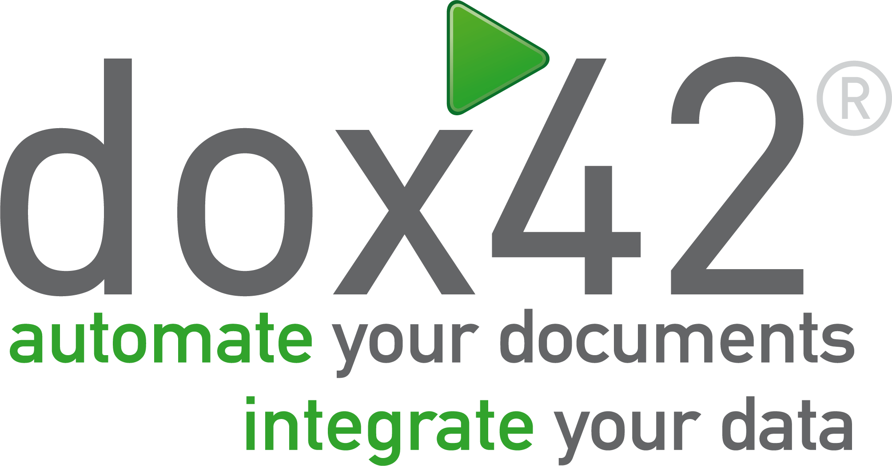






Thank You to our Sponsors…
Silver Sponsors
Online Sponsor
Lunch Sponsor

Slide 3

Daniel Laskewitz
Senior Power Platform Advocate
Microsoft
Utrecht, The Netherlands
Power Platform TikTok maker
Low Code Revolution host
PnP contributor
User Group Organizer
Ex-MVP / Ex-FTRSA
Ajax-fan
aka.ms/laskewitz

Slide 4
Agenda
Connectors
What is a connector?
Why use custom connectors?
Develop a connector
Connector types
Demo #1: build your first connector
Tools
Demo #2: download, edit & update the connector
Resources
Wrap up

Slide 5
Connectors

Slide 6
What is a connector?
API Properties
A formal definition of a REST API
Allows the REST service to talk to Microsoft Power Apps, Power Automate, and Logic Apps
Currently 1000+ connectors in the product
OpenAPI
Definition
Binary
Connector

Slide 7
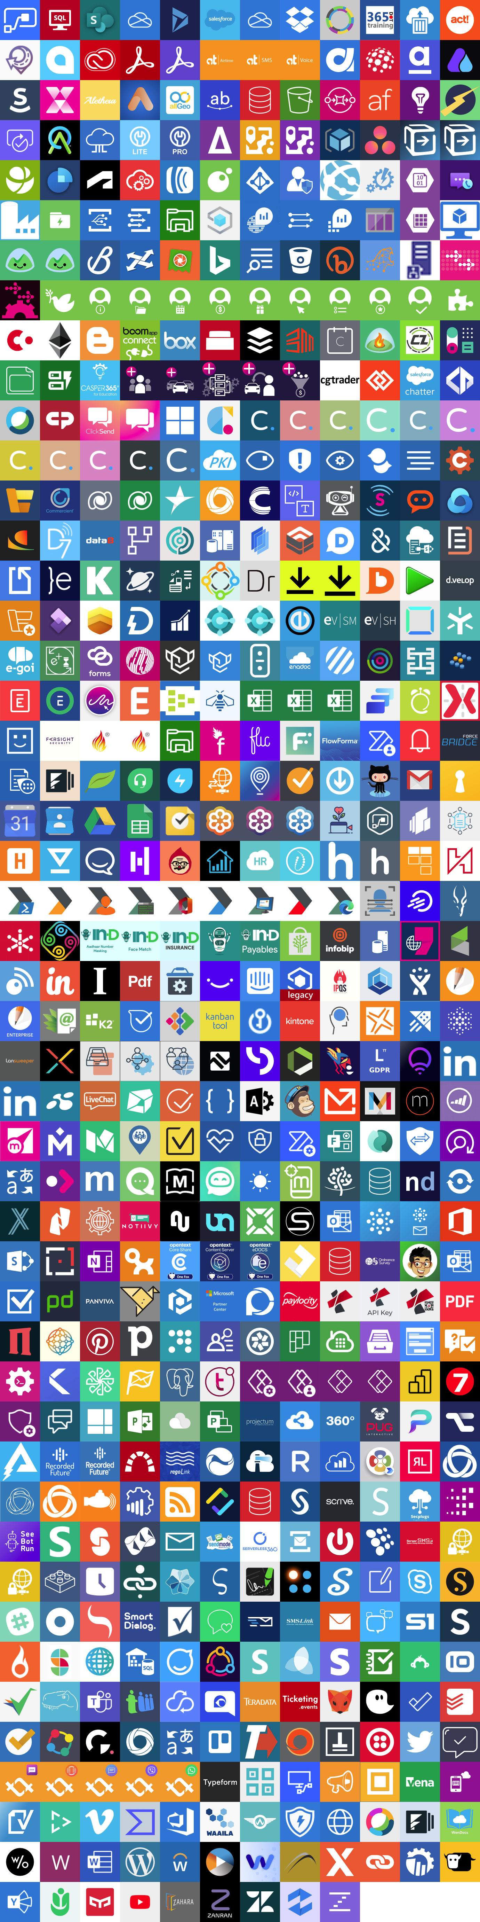
1000
1000+ Connectors

Slide 8
Why use custom connectors?
Add services that are not currently supported
Expand connectors that currently don't have the trigger/action you want
Custom connectors are simple to build, don't require a lot of coding
Can be built using the wizard, a postman collection, or with your favourite IDE
Can be shared, packaged and certified via GitHub

Slide 9
Step by step: Build a connector
Read the docs / know the API you want to build the connector for
Start in one of the products (Power Apps, Power Automate or Logic Apps)
Set up the authentication
Define the operations (triggers / actions) for your connector
Add code if needed (for now, C# code is supported)
Save and test your connector

Slide 10
Start in one of the products
Create from blank
Create from Azure Service (Preview)
Import an OpenAPI file
Import an OpenAPI from URL
Import a Postman collection
Import from GitHub

Slide 11














Type of connectors
Connector
Type
Custom Connector
Certified Connector
Independent Publisher Connector
API
Availability
Public or private
Public
Public
Service
Owner
Connector developer or someone else
Connector developer
Someone else
Audience
Internal
Everyone
Everyone

Slide 12

Demo
Build your first connector

Slide 13
Tools

Slide 14
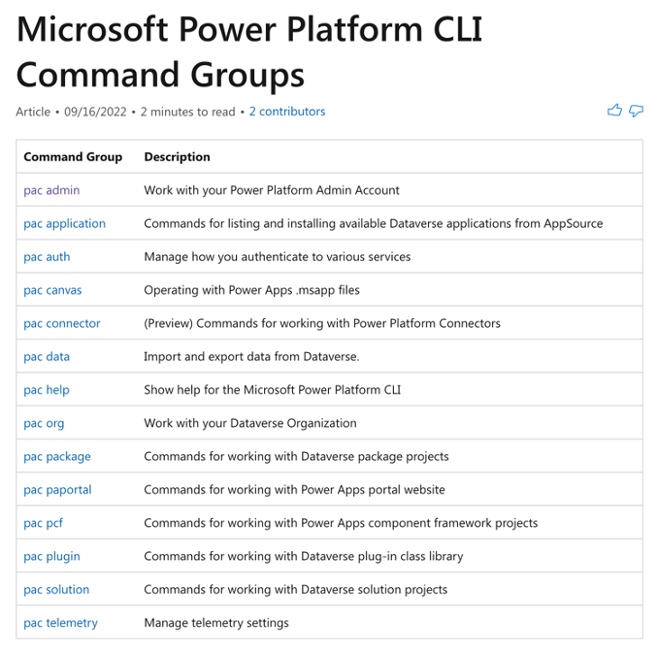
Tools (1/2)
Power Platform CLI (preview)
Helps with the ALM story of custom connectors
The following commands are available:
pac connector list
pac connector init
pac connector create
pac connector download
pac connector update

Slide 15
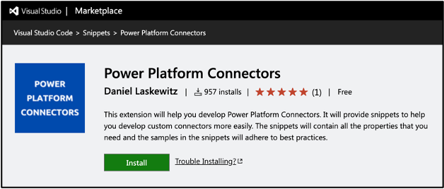
Tools (2/2)
Power Platform CLI (preview)
‘pac canvas create’ command generates a canvas app from a custom connector
This is great for pro code dev hand-off to citizen dev / makers
Power Platform Connectors (VS Code Extension)
Helps you to easily add properties and other objects in Visual Studio Code by providing snippets

Slide 16
Demo
Download, edit & update the connector.
Notes:
pac connector list
pac connector download --connector-id 392cf714-0036-4bc1-be54-c30160af6663
"x-ms-dynamic-values": { "operationId": "GetCategories" }
pac connector update --connector-id 392cf714-0036-4bc1-be54-c30160af6663 --api-definition-file apiDefinition.json

Slide 17
Resources

Slide 18
Resources (1/2)
Docs (https://aka.ms/cc/learn)
Get your connector certified (https://aka.ms/cc/certification)
Power Platform Connectors GitHub repository (https://aka.ms/cc/github)
Extend an OpenAPI Definition (https://aka.ms/cc/extend-openAPI)
Custom code in custom connectors (https://aka.ms/cc/code)
Create a connector from a Postman Collection (https://aka.ms/cc/postman)

Slide 19
Resources (2/2)
Custom Connectors Coding Standards (https://aka.ms/cc/coding-standards)
Policy support in Custom Connectors (https://aka.ms/cc/policy-templates)
Paconn CLI (https://aka.ms/cc/paconn)
Power Platform Connectors VS Code Extension (https://aka.ms/ppc-vscode)
Power Platform CLI (https://aka.ms/powerplatformcli)

Slide 20
Thanks

Slide 21
Q & A

Slide 22
Thank You to our Sponsors…
Silver Sponsors
Online Sponsor
Lunch Sponsor

